Slide 1
A mobile device with Bending sensor through Bluetooth wireless technology to synchronously operate Bionic hand for harmful gas monitor Application
Advisor : Min Yen Yeh
Officer : RUN-JUN HUANG
XING-YU WU
JIUN-GUAN SHIU

Slide 2
Outline
Motivation ………………………..……p.3
Introduction………………………….... p.4
Component introduction………………..p.5~p.6
Hardware architecture.…........................p.7~p.8
Software design…..…………………….p.9
Results………………………………….p.10~p.13
Conclusion………………………….…..p.14
Future prospects……………………......p.15
The end………..………………………..p.16

Slide 3
Motivation
1. Reduce the chance of accidents.
2. Improve work efficiency.
3

Slide 4
Introduction
1.Data transmission part:
(1) Display the sensing data of gas on APP.
2.Arm signal receiving part:
(1) Receive the value of the bending sensor on the glove.

Slide 5
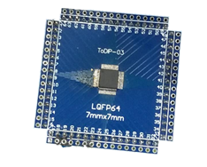
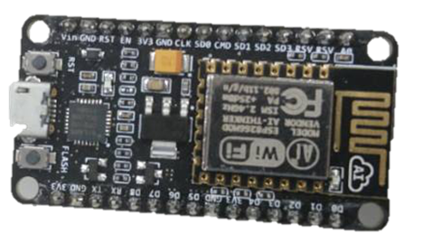
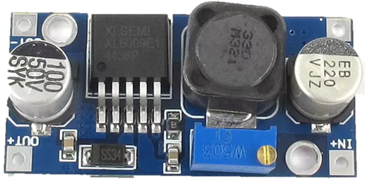
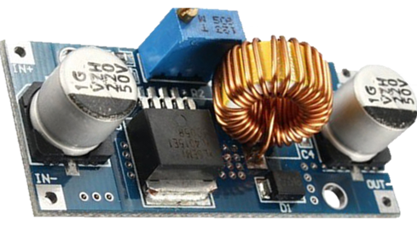
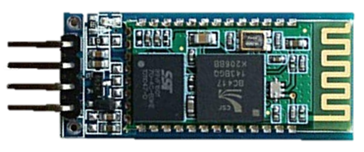
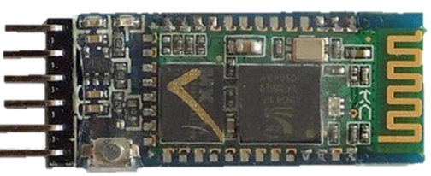
Component Introduction
MCU |  | HOLTEK HT66F2390
 |  | ESP8266 NODE MCU
Power Supply |  | XL6009
 |  | XL4015
BlueTooth |  | HC06
 |  | HC05

Slide 6
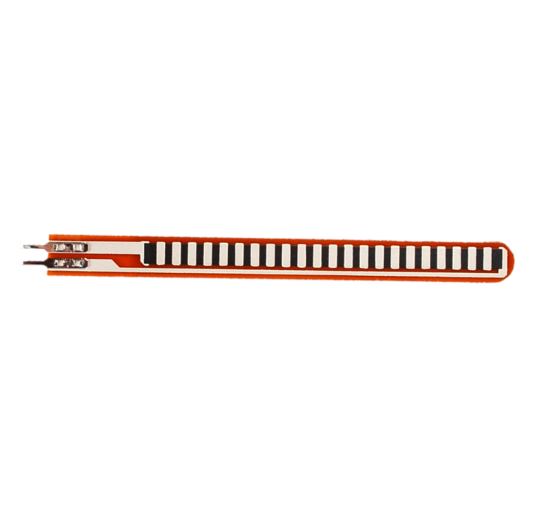
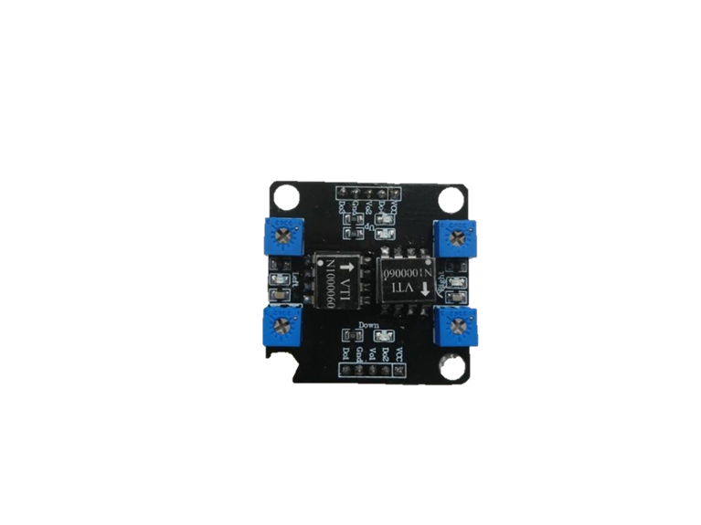
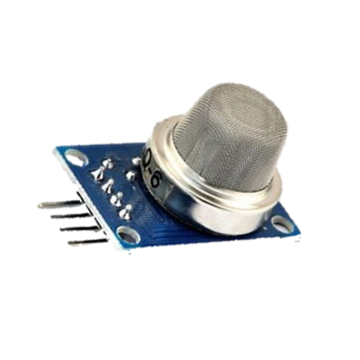
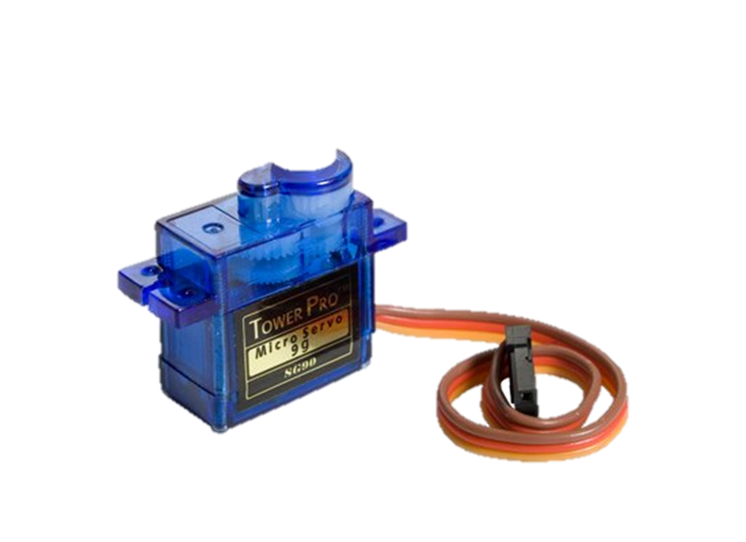
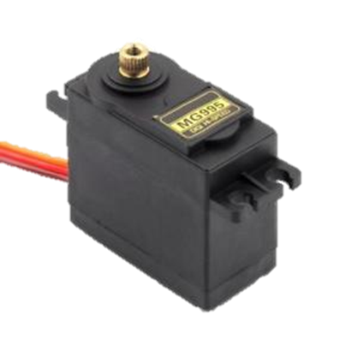
Component Introduction
Sensor |  | Bending Sensor
 |  | SCA60C
 |  | MQ-6
Servo Motor |  | SG90
 |  | MG995

Slide 7

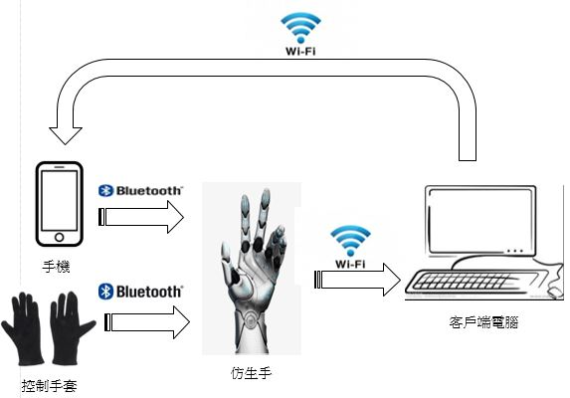
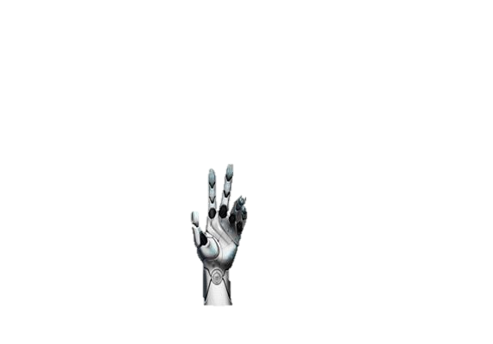


Hardware architecture
Computer
Gloves
Machine hand
Smart phone

Slide 8
Hardware architecture
Bending Sensor
HT66F2390
AD transfer
Bluetooth Send
Bluetooth receive
HT66F2390
Servo Motor

Slide 9
Software design
Gas Sensor
ESP8266 NODE MCU
Server
APP

Slide 10
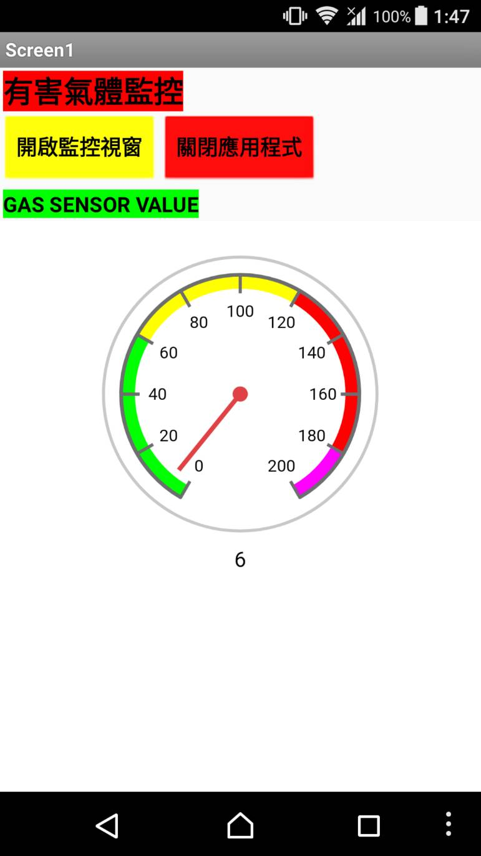
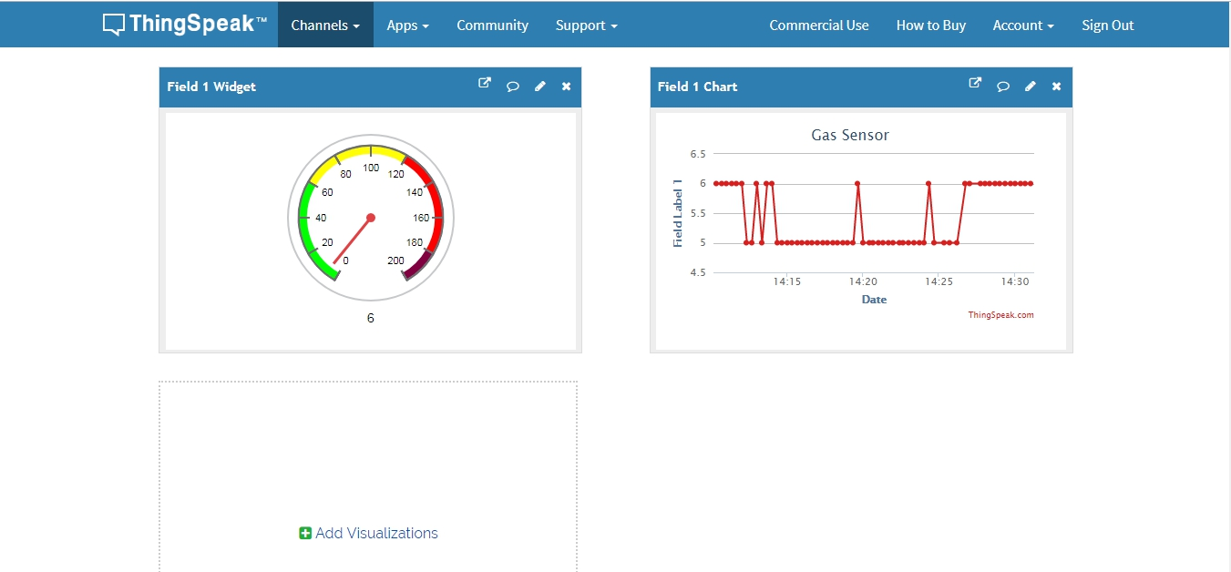
Results
(a) Web page
(b)APP

Slide 11
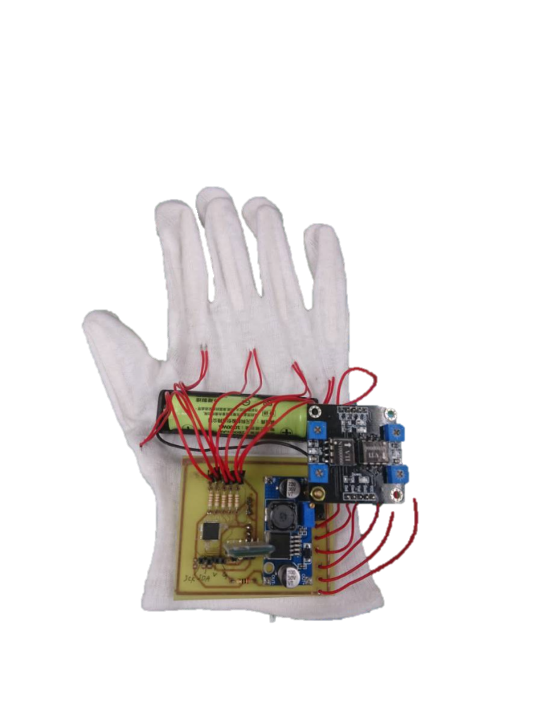
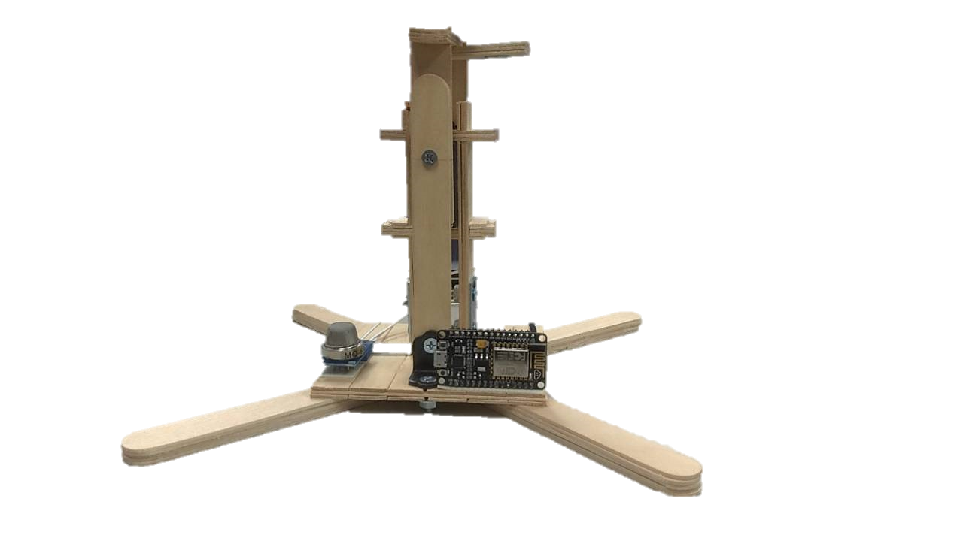
Results
Bending Sensor
SCA60C
HT66F2390
MQ-6
ESP8266
XL6009
HC05
(a)
(b)

Slide 12
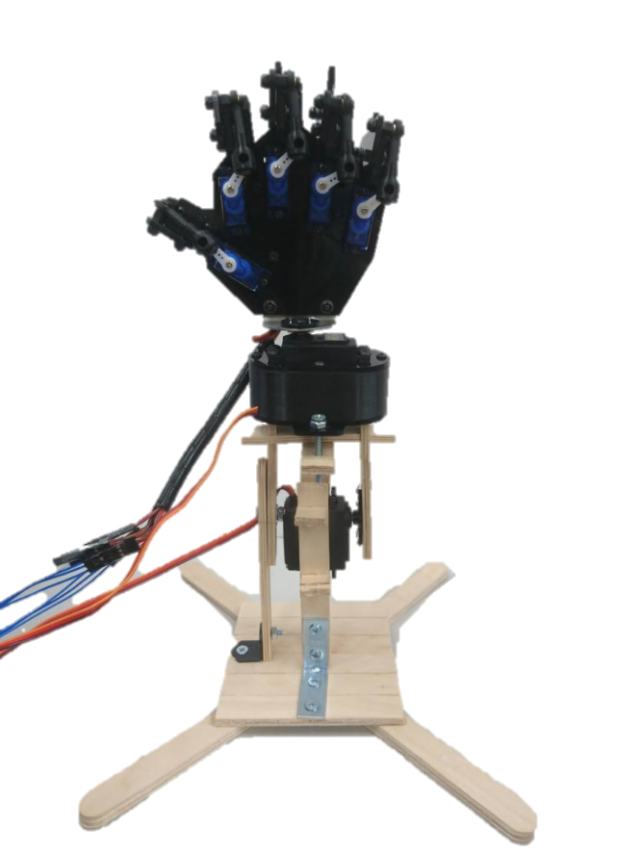
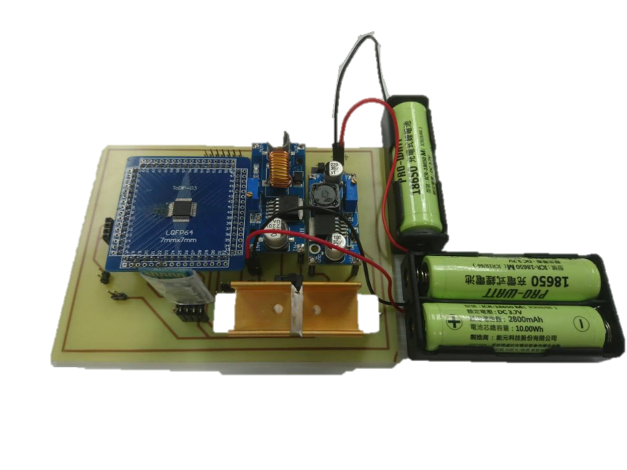
Results
SG90
XL4015
MG995
HT66F2390
MG995
XL6009
HC06
(a)
(b)

Slide 13
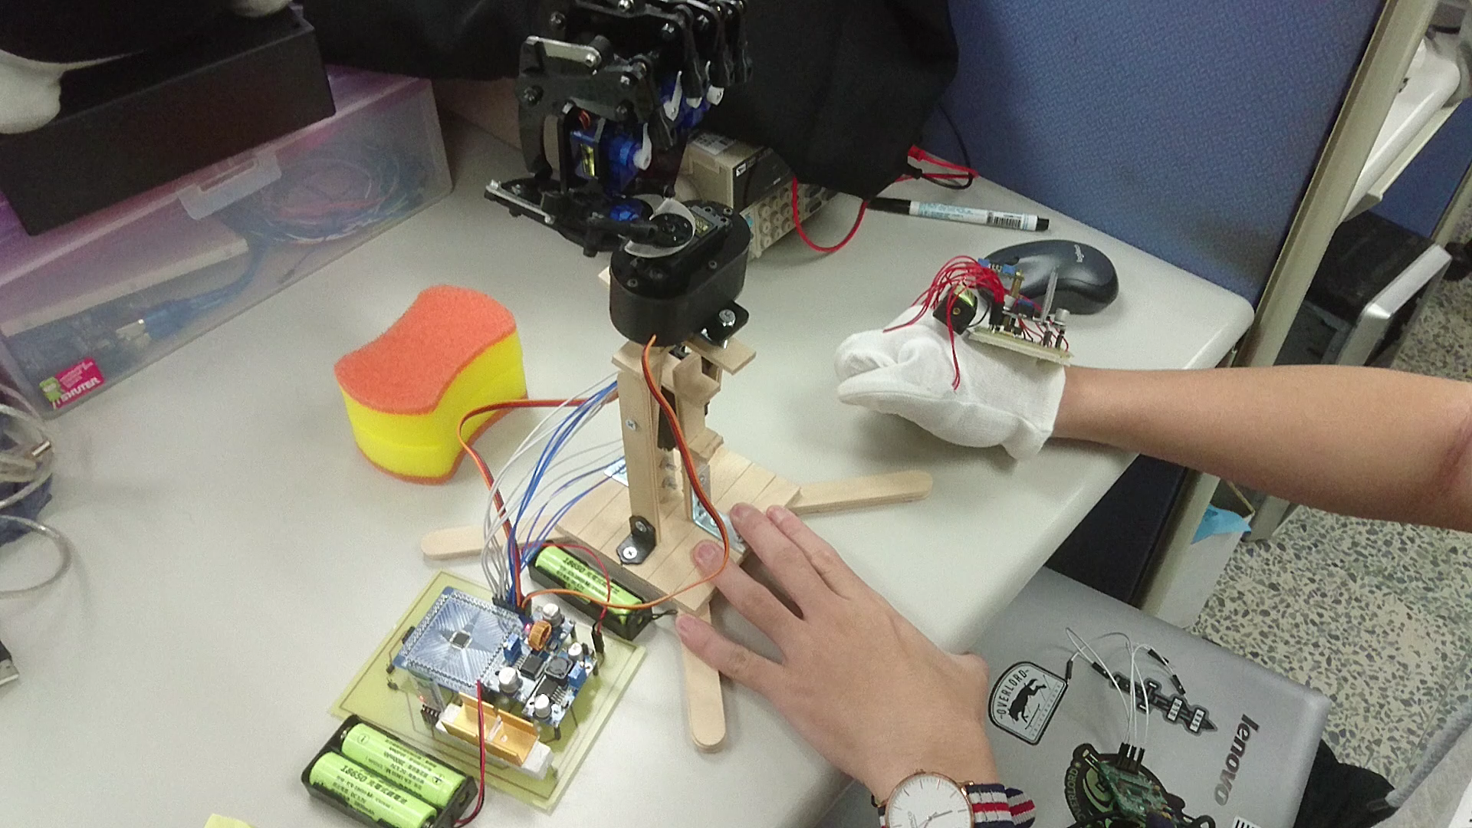
Results

Slide 14
Conclusion
Remote control robot with Bluetooth.
Monitor gas near the robot.
Show the data of gas sensor on the webpage or by smartphone.

Slide 15
Future Prospects
1.Change the source of power.
2.Try other motor types.
3.Strengthen the structure of the robot.
4.Increase the APP functions.

Slide 16
THANKS FOR LISTENING

